Slide 1

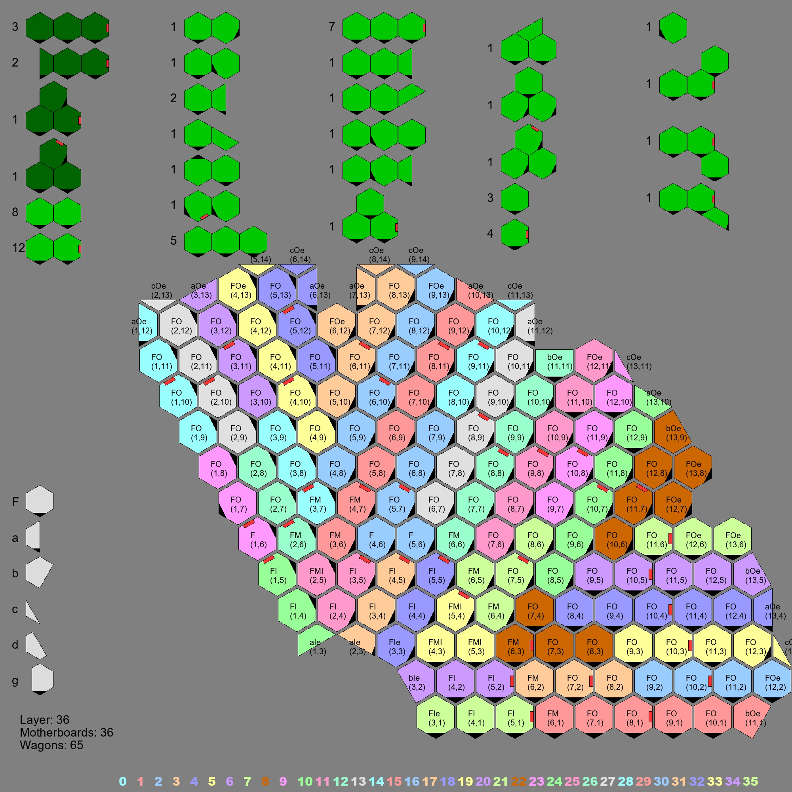
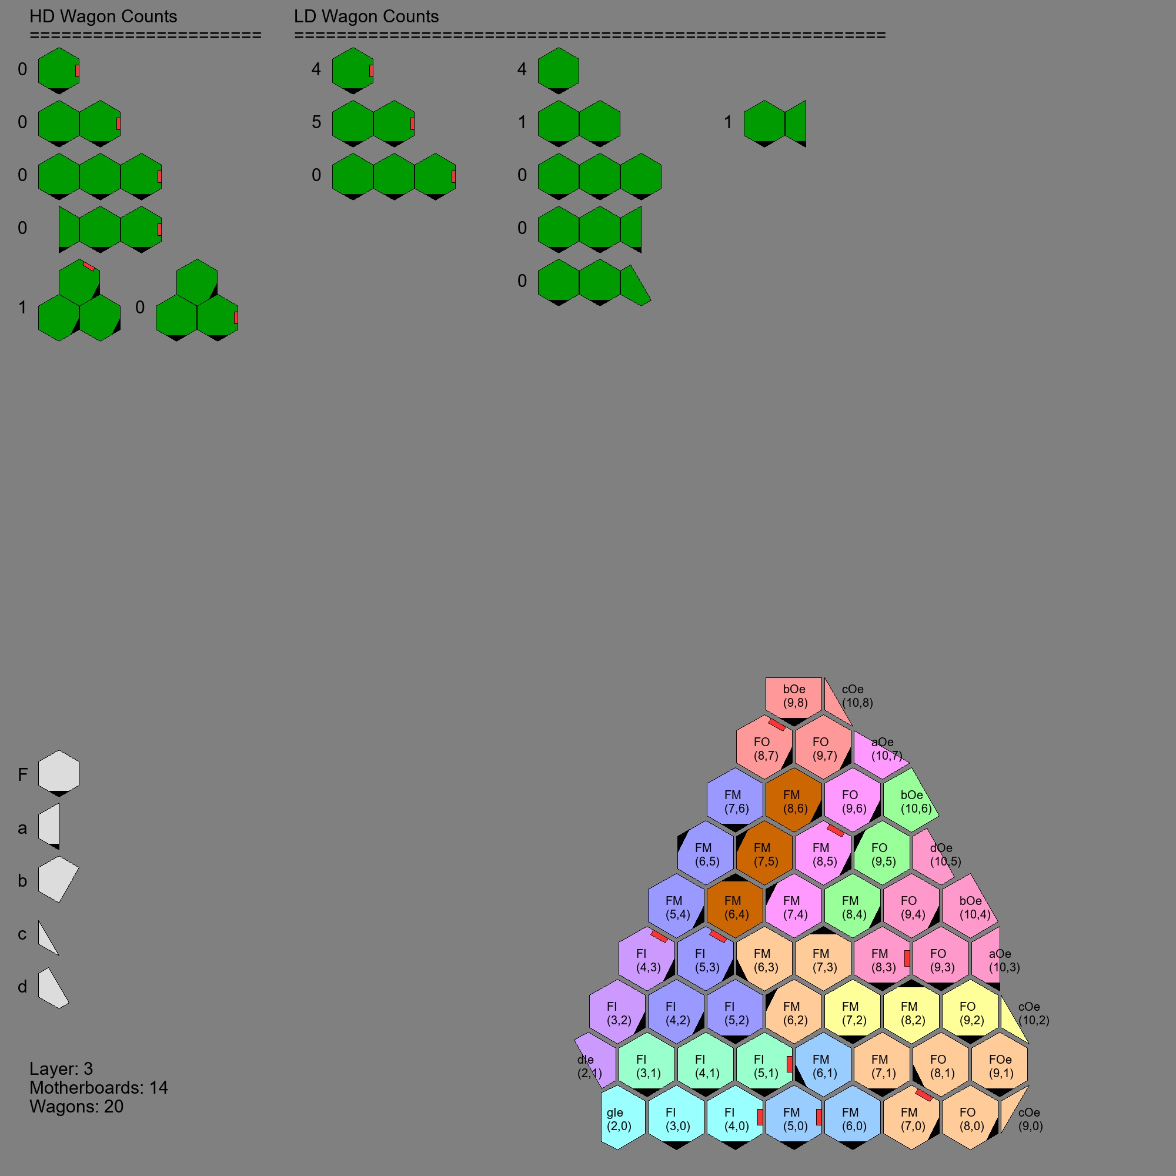
4/19/21
Wagon Counting
Gardner

Slide 2
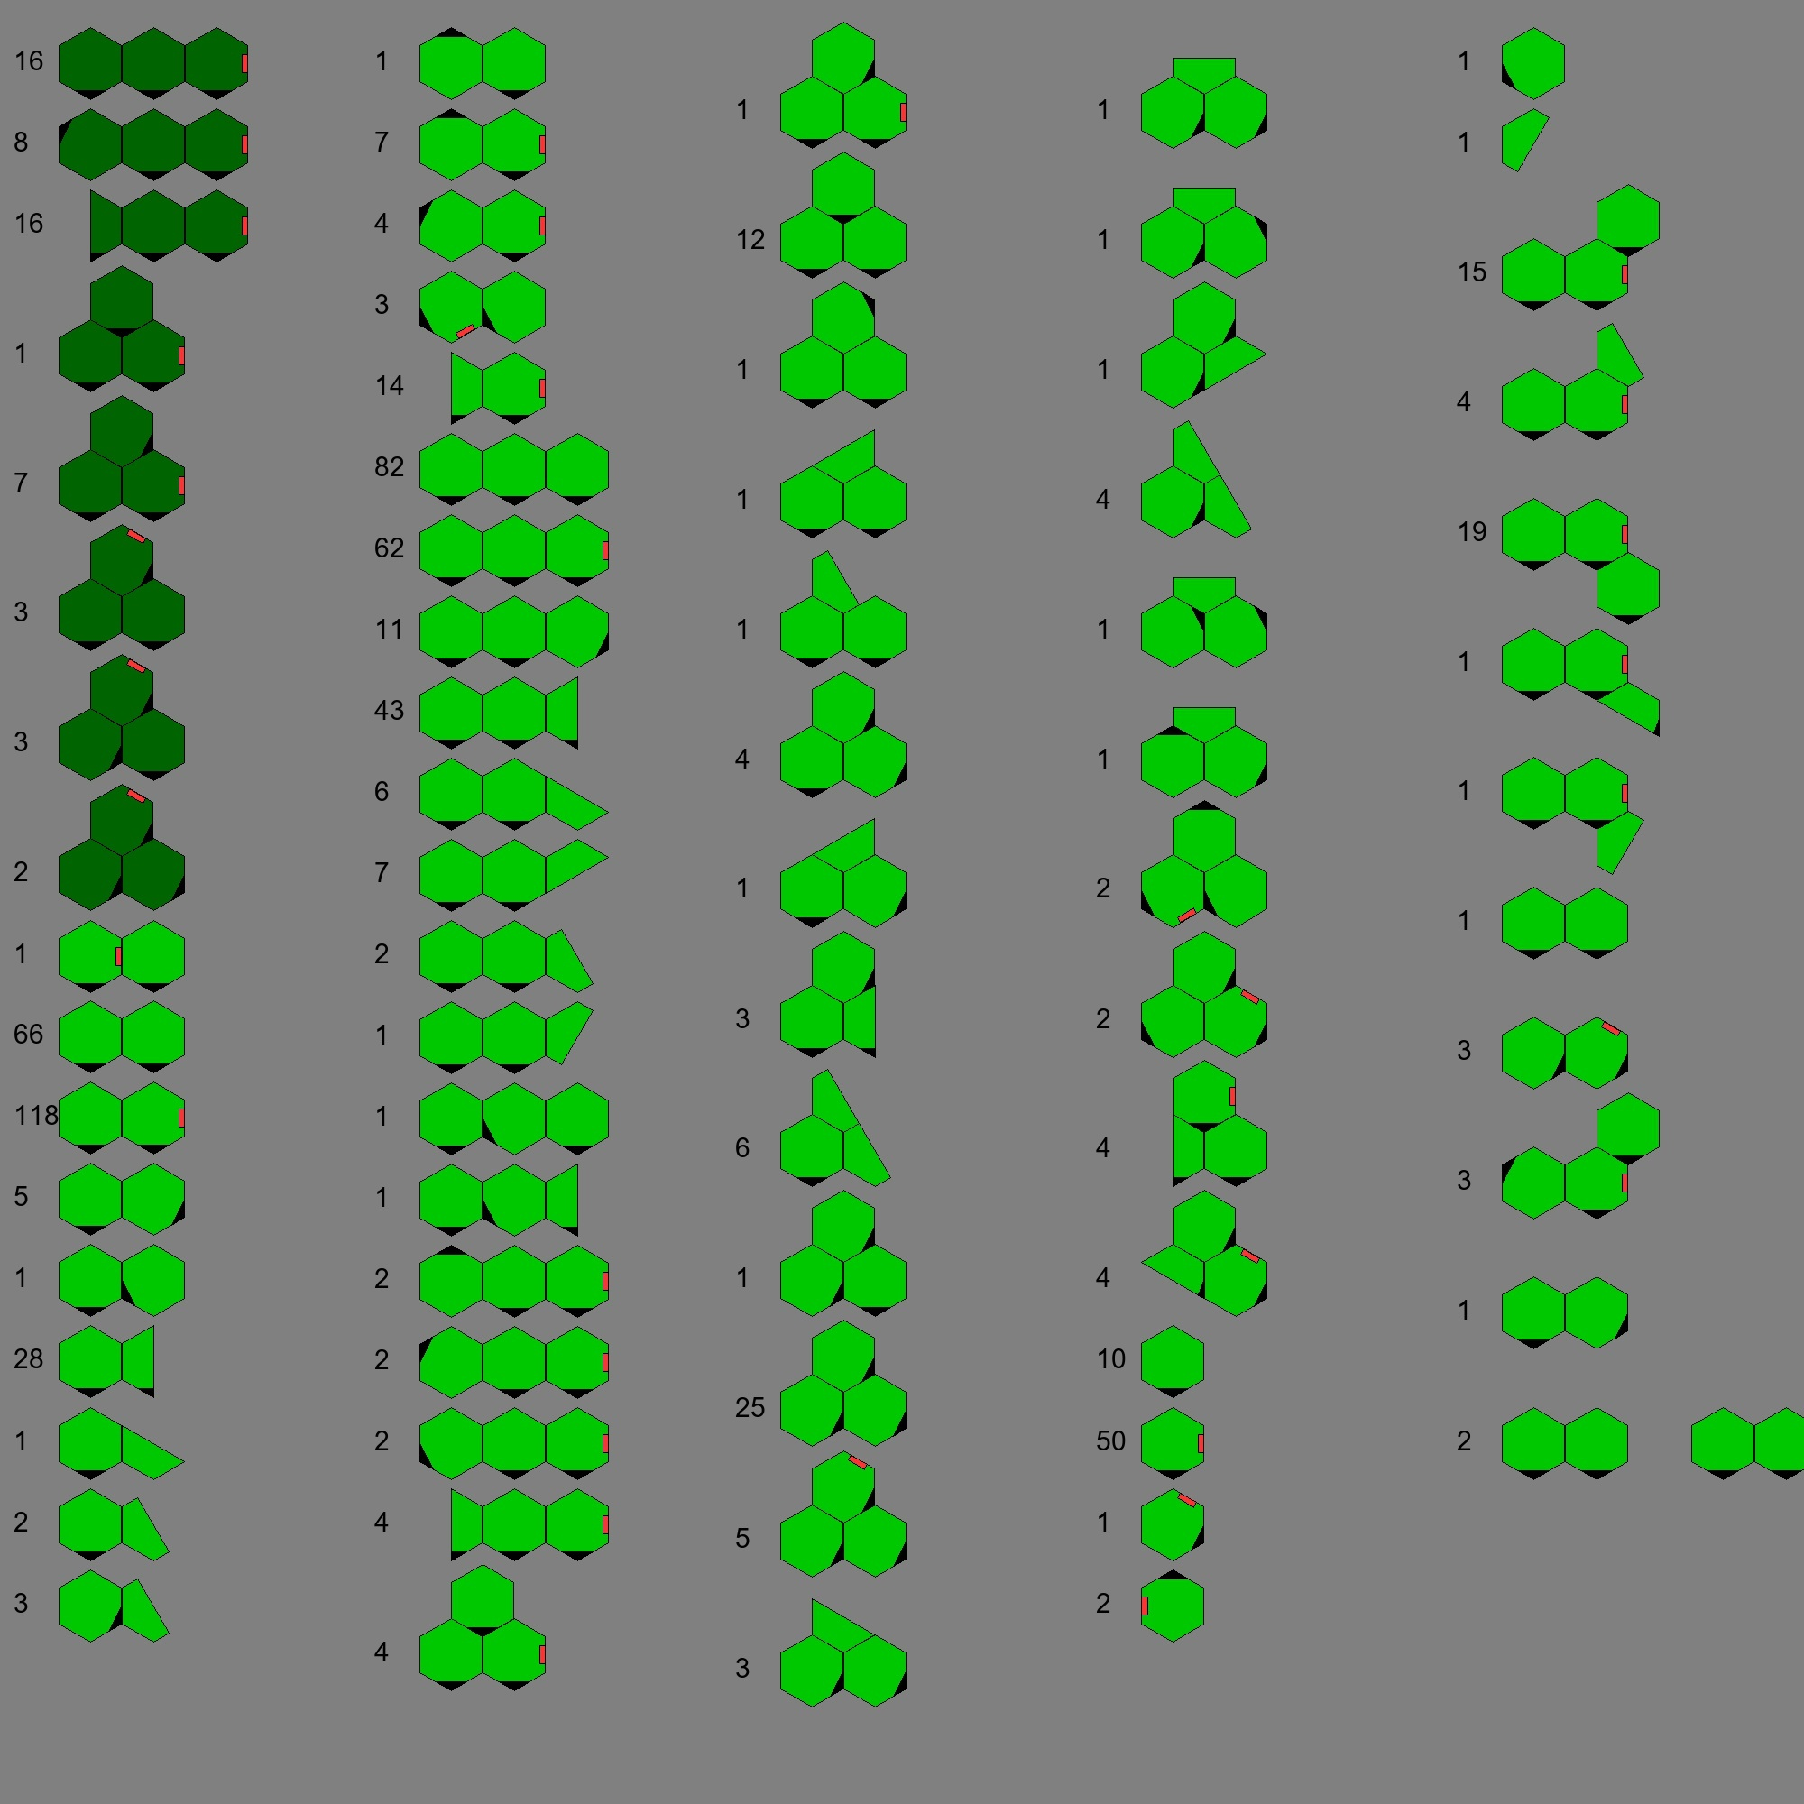
Wagon Counts
24 HDL3F0F0F0E
16 HDL3a3F0F0E
1 HDT3F0F0EF0
3 HDT3F0F0EF1
1 HDT3F0F0F1E
1 HDT3F1F0F1E
2 HDT3F1F1F1E
4 HDT3F5EF0F5
2 HDT3F5F0EF0
2 HDT3F5F0EF5
2 LDL2F0EF0
72 LDL2F0F0
118 LDL2F0F0E
1 LDL2F0F1
1 LDL2F0F5
31 LDL2F0a0
1 LDL2F0a1
2 LDL2F0d0
3 LDL2F1d0
1 LDL2F3F0
8 LDL2F3F0E
4 LDL2F4F0E
3 LDL2F5EF5
16 LDL2a3F0E
93 LDL3F0F0F0
62 LDL3F0F0F0E
43 LDL3F0F0a0
…
1 LDU1F5
1 LDU1d5
15 LDU3F0F0ER1F0
4 LDU3F0F0ER1d0
19 LDU3F0F0ER2F0
1 LDU3F0F0ER2a4
1 LDU3F0F0ER2d5
2 LDU3F0F0R9F0
3 LDU3F1F1R1F1E
4 LDU3F4F0ER1F0
1 LDU4F0F0R9F0R9F0
2 LDU5F0a0R9F0F0F0E

